Slide 1

WEB Development
Grade 7&8

Slide 2
Recap of the last Class
Notes:
Objective:
Review the previous lesson on Go Green Website .
Introduce the new topic: Navigation.
Teacher Instructions:
Review Previous Concepts (3 minutes):
Begin with a quick review of the previous lesson, focusing on scroll animations, making a webpage scrollable, the hero section, and hover effects.
Ask students to share their experiences and any challenges they faced.
Introduce today's topic:
Navigation Bar (2 min):
Explain the purpose of a navigation bar and its importance in website design.
Show examples of different types of navbars from popular websites.

Slide 3
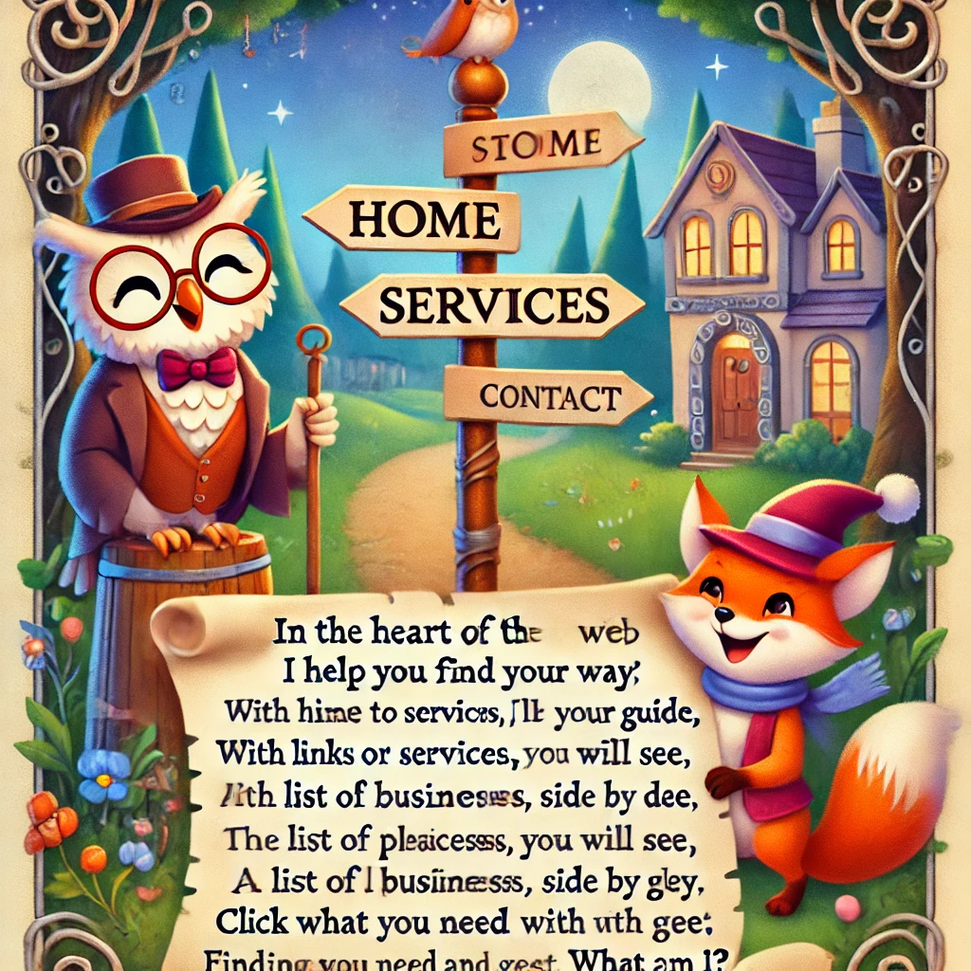
Mystery of the Web Guide
In the heart of the web, I help you find your way,
With links to guide you, come night or day.
From home to services, I'll be your guide,
To all local businesses, side by side.
On the top or side, you will see,
A list of places to explore with glee.
Click on me to start your quest,
Finding what you need with ease and zest.
What am I?
Notes:
Ans : I am the navigation bar (navbar)
Teacher Instructions:
Present the riddle to the class.
Encourage students to think about elements of web design and navigation.
Read the riddle aloud and display it on the board or screen.

Slide 4
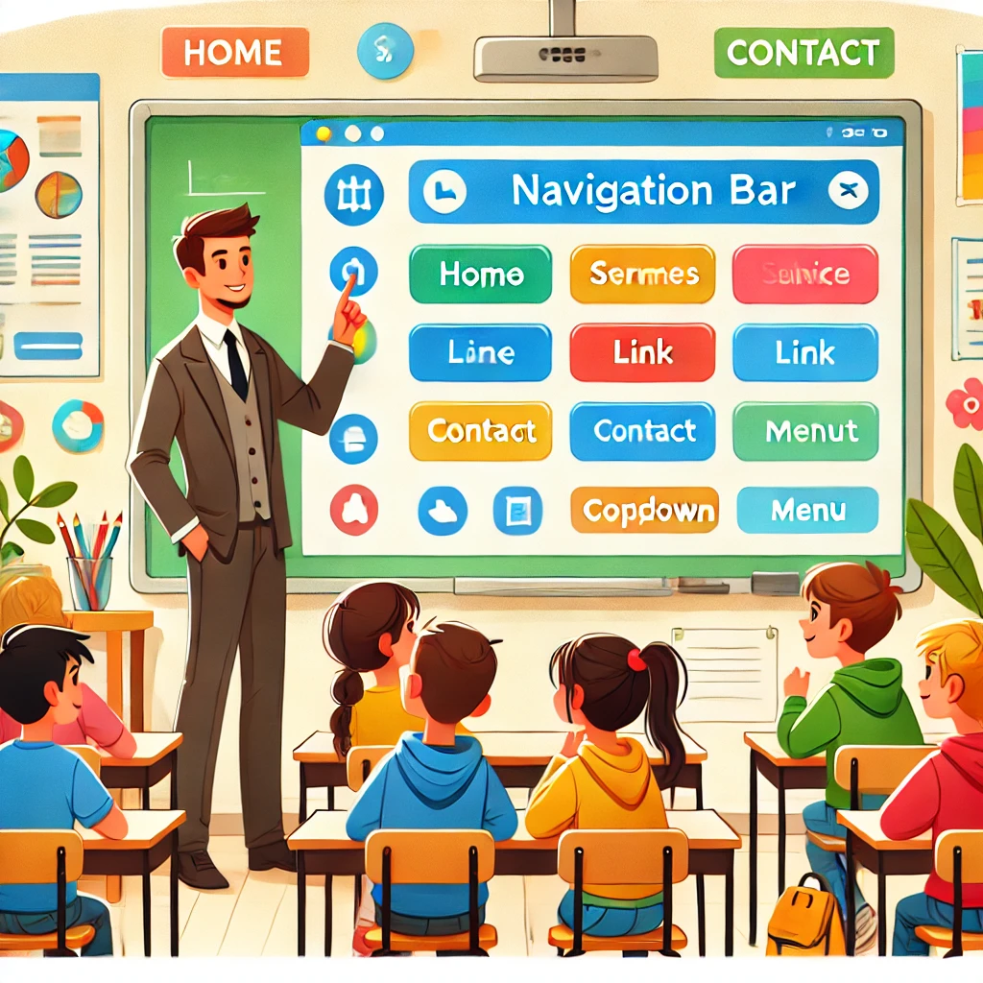
Introduction to Navigation
Notes:
Objective:
Introduce the concept of navigation and hero sections in web design.
Teacher Instructions:
Introduction to Navigation:
Introduction to Navigation (2 minutes)
Begin by explaining the importance of navigation on a website.
Use the image to show an example of a navigation bar.
Discuss how a navigation bar helps users find information quickly and easily.
Components of a Navigation Bar (2 minutes)
Describe the key components of a navigation bar:
Logo: Represents the brand or website name.
Home Link: Takes users back to the homepage.
Services Link: Leads to information about services offered.
Contact Link: Provides ways to contact the business or website owner.
Dropdown Menu: Contains additional links or categories.
Use the interactive whiteboard in the image to point out each component.

Slide 5
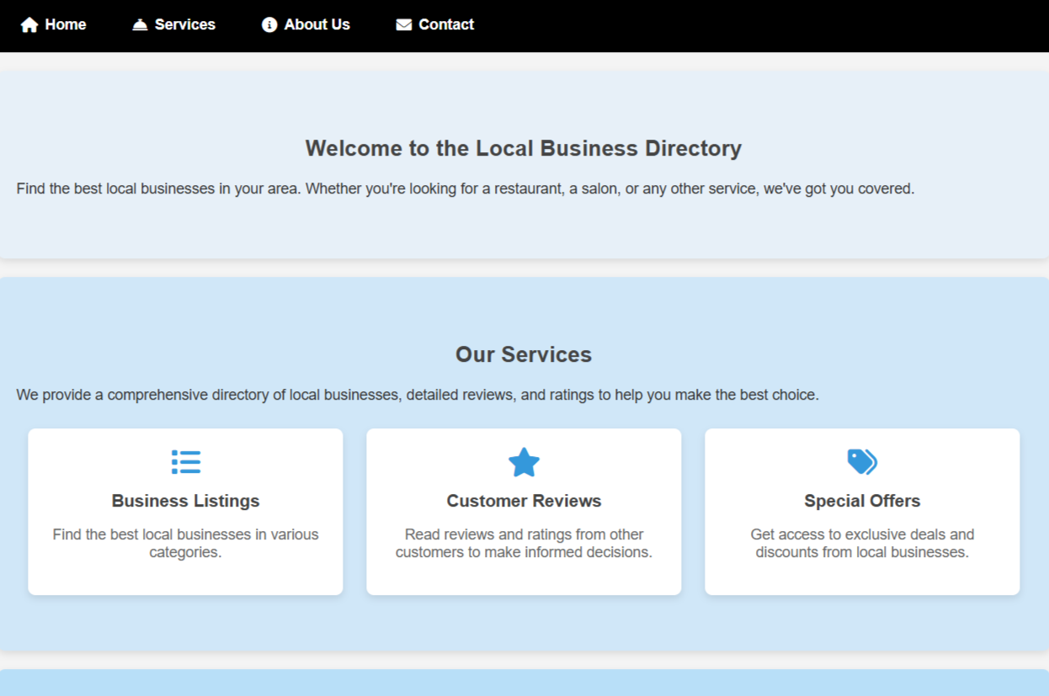
Project – Local Business Directory
Notes:
Project Link: Local Business Directory
Objective:
Present the final project example.
Teacher Instructions:
Show the Screenshot:
Display the screenshot of the final project example.
Show the Project in Live Action:
Demonstrate the project on a live website to show how it functions.
Navigate through the website to showcase the nav bar in action by clicking on each nav items.
Emphasize the importance of navigation bar.
Explain the Project:
Inform students that they will create a similar project.
Highlight the key features:
A clear and user-friendly nav section.
An engaging webpage.

Slide 6
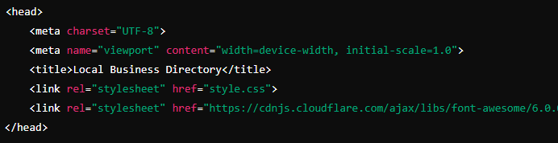
Working with the Project
HTML Code Explanation
head section of an HTML Document
Notes:
Project Link: Local Business Directory
Objective:
Explain the basic structure of an HTML document and how to insert the cloud flare icons pack.
Teacher Instructions:
Display the screenshot of the HTML code.
Provide an overview of the basic structure:
<head>: Contains metadata and links to stylesheets.
<meta charset="UTF-8">: Sets the character encoding to UTF-8.
<meta name="viewport" content="width=device-width, initial-scale=1.0">: Ensures the page is responsive on all devices.
<title>Local Business Directory</title>: Sets the title of the webpage.
<link rel="stylesheet" href="style.css">: Links to the external CSS file for styling.
<link rel="stylesheet" href="https://cdnjs.cloudflare.com/ajax/libs/font-awesome/6.0.0-beta3/css/all.min.css">: Links to the Font Awesome CSS for using icons.

Slide 7
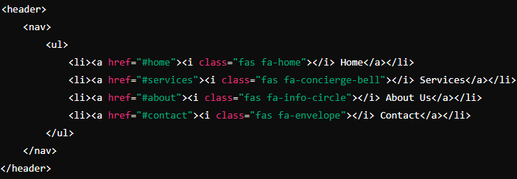
Working with the Project
Header and Navigation Bar:
Notes:
Teacher Instructions:
Project Link: Local Business Directory
Teacher Instructions:
Display the screenshot of the HTML code.
Provide an overview of the HTML code:
<header>: Defines the header section.
<nav>: Contains the navigation bar.
<ul>: Creates an unordered list for navigation links.
<li>: List item, each containing a navigation link.
<a href="#home"><i class="fas fa-home"></i> Home</a>: Link to the home section, with an icon and text.
href="#home": Link to the section with the ID "home".
<i class="fas fa-home"></i>: Font Awesome icon for home.

Slide 8
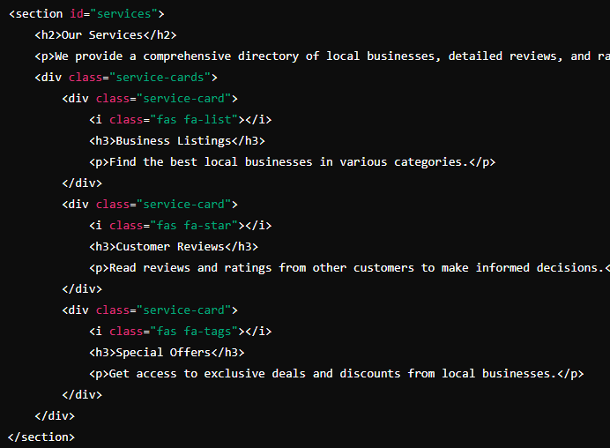
Working with the Project
Service Section:
Notes:
Teacher Instructions:
Project Link: Local Business Directory
Teacher Instructions:
Display the screenshot of the HTML code.
Provide an overview of the HTML code:
<section id="services">: Defines a section with the ID "services".
<h2>Our Services</h2>: Heading for the section.
<p>We provide a comprehensive directory... </p>: Paragraph describing the services.
<div class="service-cards">: Container for service cards.
<div class="service-card">: Individual service card.
<i class="fas fa-list"></i>: Icon representing business listings.
<h3>Business Listings</h3>: Subheading for the service.
<p>Find the best local businesses... </p>: Description of the service.

Slide 9
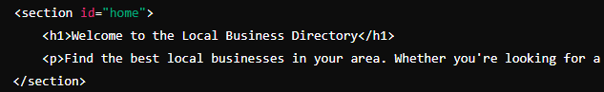
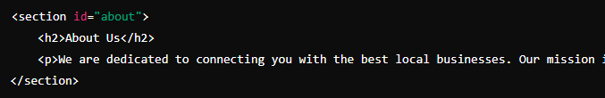
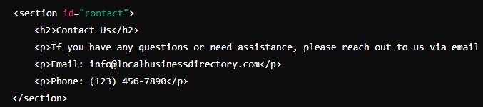
Working with the Project
Home Section, About us Section and Contact Us Section:
Notes:
Teacher Instructions:
Project Link: Local Business Directory
Teacher Instructions:
Display the screenshot of the HTML code.
Provide an overview of the HTML code:
Home Section:
**Put this before the Service Section**
<section id="home">: Defines a section with the ID "home".
<h1>Welcome to the Local Business Directory</h1>: Main heading for the section.
<p>Find the best local businesses in your area... </p>: Paragraph providing an introduction.
About Us and Contact Us Section:
**Put this after the Service Section**
<section id="about">: Defines a section with the ID "about".
<h2>About Us</h2>: Heading for the section.
<p>We are dedicated to connecting... </p>: Paragraph providing information about the organization.
<section id="contact">: Defines a section with the ID "contact".
<h2>Contact Us</h2>: Heading for the section.
<p>If you have any questions or need... </p>: Paragraph providing contact information.
<p>Email: info@localbusinessdirectory.com </p>: Paragraph with email contact.
<p>Phone: (123) 456-7890</p>: Paragraph with phone contact.

Slide 10
Html Structure Done
Let's Style it Now
Notes:
Objective:
Review the code till now
Project Link: Go Green Pathways
Teacher Instructions:
Recap the key points.
Encourage interactive discussion and exploration of form elements like text inputs, checkboxes, and submit buttons.

Slide 11
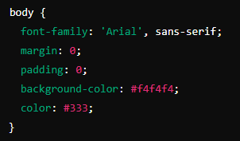
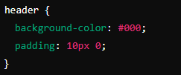
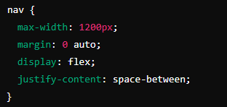
Working with the Project
CSS Code Explanation:
Global Styles, Header and Navigation Styles:
Notes:
Objective:
Project Link: Local Business Directory
Explain Global Styles:
Explain the importance of global styles for consistency using the universal selector *.
Discuss the use of flex and justify content to arrange nav elements
Teacher Instructions:
Display the screenshot of the CSS code.
Explain the styling for the header:
body: This sets the overall styling for the body of the document.
font-family: 'Arial', sans-serif;: Uses Arial font with a fallback to sans-serif.
margin: 0;: Removes any default margin.
padding: 0;: Removes any default padding.
background-color: #f4f4f4;: Sets a light gray background color.
color: #333;: Sets the text color to a dark gray.
header: Styles the header area.
background-color: #000;: Sets the background color to black.
padding: 10px 0;: Adds padding on the top and bottom.
nav: Styles the navigation bar.
max-width: 1200px;: Limits the maximum width to 1200 pixels.
margin: 0 auto;: Centers the navigation bar within the header.
display: flex;: Uses flexbox for layout.
justify-content: space-between;: Distributes space evenly between elements.

Slide 12
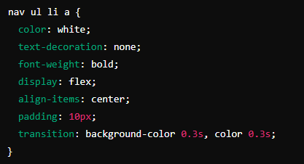
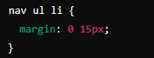
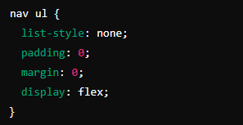
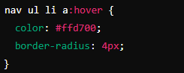
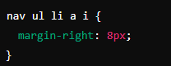
Working with the Project
Styling Navigation elements and applying hover effect :
Notes:
Project Link: Local Business Directory
Objective:
Explain the CSS code for styling the ul, li items and applying hover effect.
Teacher Instructions:
Code Explanation:
nav ul: Styles the unordered list in the navigation bar.
list-style: none;: Removes default list bullets.
padding: 0;: Removes default padding.
margin: 0;: Removes default margin.
display: flex;: Uses flexbox for horizontal layout.
nav ul li: Styles the list items in the navigation bar.
margin: 0 15px;: Adds horizontal margin between items.
nav ul li a: Styles the links in the navigation bar.
color: white;: Sets the text color to white.
text-decoration: none;: Removes the underline from links.
font-weight: bold;: Makes the text bold.
display: flex;: Uses flexbox for horizontal layout.
align-items: center;: Vertically centers the link content.
padding: 10px;: Adds padding around the links.
transition: background-color 0.3s, color 0.3s;: Adds a transition effect for background and text color changes.
nav ul li a i: Styles the icons within the links.
margin-right: 8px;: Adds right margin to separate the icon from the text.
nav ul li a:hover: Styles the hover state for links.
color: #ffd700;: Changes text color to gold.
border-radius: 4px;: Adds rounded corners.

Slide 13
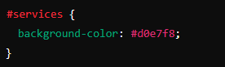
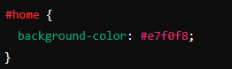
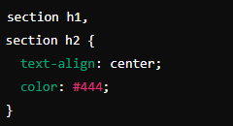
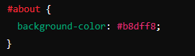
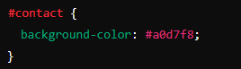
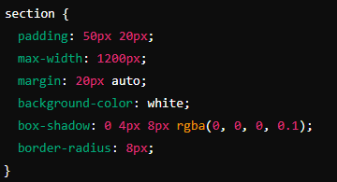
Working with the Project
Styles the Section:
Notes:
Project Link: Local Business Directory
Objective:
Explain the CSS code for styling the sections.
Teacher Instructions:
Display the screenshot of the CSS code.
Explain the styling for the Title Styles:
section: Styles all section elements.
padding: 50px 20px;: Adds padding inside the sections.
max-width: 1200px;: Limits the maximum width to 1200 pixels.
margin: 20px auto;: Adds vertical margin and centers the sections.
background-color: white;: Sets the background color to white.
box-shadow: 0 4px 8px rgba(0, 0, 0, 0.1);: Adds a shadow effect.
border-radius: 8px;: Adds rounded corners.
section h1, section h2: Styles the headings within sections.
text-align: center;: Centers the text.
color: #444;: Sets the text color to dark gray.
#home: Styles the home section.
background-color: #e7f0f8;: Sets a light blue background color.
#services: Styles the services section.
background-color: #d0e7f8;: Sets a slightly darker light blue background color.
#about: Styles the about section.
background-color: #b8dff8;: Sets a moderate light blue background color.
#contact: Styles the contact section.
background-color: #a0d7f8;: Sets a darker light blue background color.

Slide 14
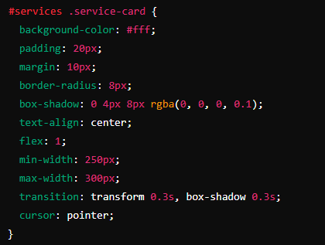
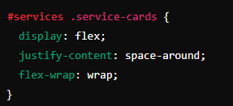
Working with the Project
Service Card Styles
Notes:
Project Link: Local Business Directory
Objective:
Explain the CSS code to style service card and make it interactive.
Teacher Instructions:
Display the screenshot of the CSS code.
Explain the styling for Service Cards:
#services .service-cards: Styles the container for service cards.
display: flex;: Uses flexbox for layout.
justify-content: space-around;: Distributes space evenly between cards.
flex-wrap: wrap;: Allows cards to wrap onto multiple lines.
#services .service-card: Styles individual service cards.
background-color: #fff;: Sets the background color to white.
padding: 20px;: Adds padding inside the cards.
margin: 10px;: Adds margin around the cards.
border-radius: 8px;: Adds rounded corners.
box-shadow: 0 4px 8px rgba(0, 0, 0, 0.1);: Adds a shadow effect.
text-align: center;: Centers the text inside the cards.
flex: 1;: Allows the cards to grow and shrink.
min-width: 250px;: Sets the minimum width to 250 pixels.
max-width: 300px;: Sets the maximum width to 300 pixels.
transition: transform 0.3s, box-shadow 0.3s;: Adds transition effects.
cursor: pointer;: Changes the cursor to a pointer on hover.

Slide 15
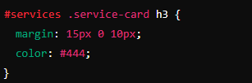
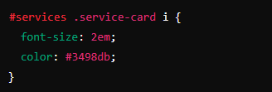
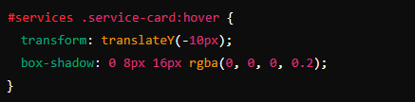
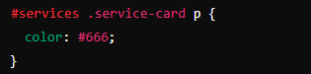
Working with the Project
Notes:
Project Link: Local Business Directory
Objective:
Teacher Instructions:
Display the screenshot of the CSS code.
Explain the Service Card Css:
#services .service-card i: Styles the icons in the service cards.
font-size: 2em;: Sets the font size to 2em.
color: #3498db;: Sets the icon color to blue.
#services .service-card h3: Styles the headings in the service cards.
margin: 15px 0 10px;: Adds vertical margin around the headings.
color: #444;: Sets the text color to dark gray.
#services .service-card p: Styles the paragraphs in the service cards.
color: #666;: Sets the text color to gray.
#services .service-card:hover: Styles the hover state for service cards.
transform: translateY(-10px);: Moves the card up on hover.
box-shadow: 0 8px 16px rgba(0, 0, 0, 0.2);: Adds a stronger shadow effect on hover.

Slide 16

Now it's your turn!
Task:
try to add one more section to the page and add the navigation to them from navbar
Instructions: Share the code with others and work as a group to give your own personalization to the final web page.
Notes:
"Students' Activity"
Objective:
Students will learn how to collaboratively add a new section to a web page and update the navigation bar accordingly. They will personalize the final web page by working together and sharing their code.
Teacher Instructions:
Divide students into small groups.
Instruct each group to:
Add the new section to their HTML file.
Update the navigation bar to include a link to the new section.
Personalize the new section with their own content and styling.
Encourage students to share their code with group members and collaborate on the final design.
provide assistance and answer questions.

Slide 17

How to Save & Share the project.
Replit offers autosave option – so not worry about the same.
To share project with someone in view mode: just copy the link from the URL bar, and share the link
To share the project for collaboration
Click on "Invite" from the top right corner
If you know the username, type it in the box and click on invite
You can also turn on the toggle button "private join link" to create a public collaboration link and invite members to edit your code.
Notes:
Instructions for the Teacher:
Explain how to save and share projects on Replit, including the options for collaboration.
Emphasize the importance of sharing projects for feedback and collaboration.

Slide 18


What is the primary purpose of a navigation bar on a website?
A) To display advertisements
B) To help users navigate to different sections of the website
C) To show images and videos
D) To display the website's terms and conditions
Notes:
Answer: B) To help users navigate to different sections of the website

Slide 19
Which HTML element is commonly used to create a navigation bar?
A) <header>
B) <nav>
C) <footer>
D) <section>
Notes:
Answer: B) <nav>

Slide 20
What does the attribute href="#services" do in a navigation link?
A) Links to an external website
B) Links to an email address
C) Links to a section with the ID "services" on the same page
D) Links to a different page on the website
Notes:
Answer: C) Links to a section with the ID "services" on the same page

Slide 21
How do you add rounded corners to a navigation link using CSS?
A) border-color
B) border-radius
C) padding
D) margin
Notes:
Answer: B) border-radius

Slide 22

What have we learnt?
What We Learned Today
HTML Tags
CSS Properties
Navigation Bar
Responsive Bar
Flexbox
Icons
Notes:
Objective:
Summarize the key learnings from the lesson.
Teacher Instructions:
Ask students to tell something on each of the topics
Teacher Notes:
HTML Tags: Elements used to structure the content on a webpage.
CSS Properties: Attributes used to style HTML elements and control their appearance.
Navigation Bar: A crucial part of a website that helps users navigate between different sections.
Responsive Design: Ensuring that the webpage looks good and functions well on all devices.
Flexbox: A CSS layout module that makes it easier to design flexible and responsive layout structures.
Icons: Visual elements added to enhance the user interface, often implemented using Font Awesome.

Slide 23

Homework Discussion
Notes:
Instructions for the Teacher: Facilitate a discussion about the homework assignment.

Slide 24

Brain Booster Bonus
Bonus Website Project: "The Ultimate Showcase Website".
you'll be designing a website with four key sections: Gallery, Blog, Testimonials, and Contact. .
Notes:
Objective: Instruct the student to create the website.
Sections to Create:
Gallery Section
Display a collection of images in a grid layout.
Add hover effects for interactivity.
Blog Section
Include posts with a title, date, author, and short description.
Style the posts to be visually appealing.
Testimonials Section
Show customer testimonials in card format.
Include names and feedback, with hover effects on cards.
Contact Section
Create a contact form with fields for name, email, subject, and message.
Style the form to match the website theme.

Slide 25

Be Skeptical of Promises
If something online sounds too good to be true, like 'free games for life,' it could be a trick.
Oliver saw an ad online promising "free games for life" and eagerly clicked on it, hoping for a great deal.
Instead, his computer got infected with malware, causing a lot of problems.
The moral of the story: don't believe ads or emails promising free stuff without checking with an adult first, as it could be a trick.

